Slide 1

Continuous Architecture
Work In Progress
Modeling Approach

Slide 2
Modularity
“The modularizations include the design decisions which must be made before the work on independent modules can begin.”, D.L. Parnas, 1972
Strategic DDD
Why modularize?
Reduce need for coordination: separate teams can work with little need for communication
Simplify comprehension: study the system one module at a time
Lower the cost of change: make significant changes to one module without a need to change others
Criteria used in dividing the system into sub-systems and modules
Market Segment, Product, Territory, Activity Group, Organizational Unit, etc.
Ubiquitous Language, Bounded Context, Domain Events
Information Hiding
Class-responsibility-collaboration (CRC) cards to help define boundaries materialized by interfaces that reveal as little as possible about the inner workings of a module

Slide 3
Modeling Approach Overview
“Hierarchy, I shall argue, is one of the central structural schemes that the architect of complexity uses”
The architecture of complexity, Simon 1962
Experience Requirements
Product Scenarios
Strategic DDD Scenarios
Jobs Hierarchy
Jobs To Be Done Analysis
Jobs Maps
Journey Mapping
Value Stream Mapping
Event Storming
Jobs Stories
Journey Steps
VS Steps
Domain Events
Entity Objects & Life Cycles
* Non-Abstract Large System Design
User Stories
Product Design
Commonality Analysis
Bounded Context Canvasing
Jobs Stories Clustering
Candidate Product
Components
** System-Theoretic Process Analysis
Features
Candidate Shared Capability
Boundaries & Dependencies
Evolution & Emergence
Product Hierarchy
Operations Hierarchy
Software & Hardware Hierarchy
System Thinking
Design Structure Matrix (DSM) Analysis
Collaboration and Responsibility Analysis
NALSD*
STAMP**
Etc.

Slide 4
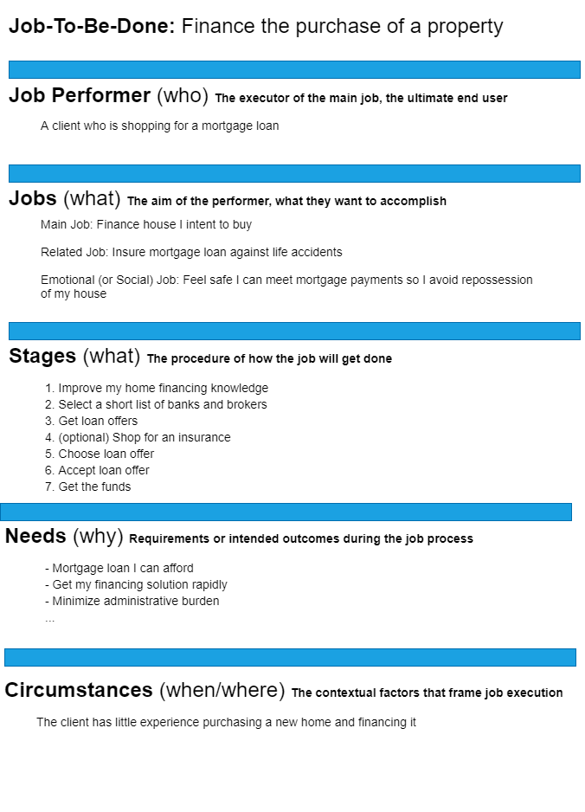
JTBD Template
A job is a goal or an objective independent of your solution
A job statement is Verb + Object + Clarifier
It shouldn’t include adjectives like quick, easy, or inexpensive which are needs
The aim of the job performer is not to interact with your company, but to get something done
Your service is a means to an end, and you must first understand that end
Strive to frame jobs in a way that makes them stable, even as technology changes
Install Draw-io :
https://draw-io.en.softonic.com/
Double click on the icon below:
Source: Jim Kalbach, The Jobs To Be Done Playbook

Slide 5
Needs
Desired outcome statements.
Direction of change + unit of measure + object + clarifier
Direction of change
How does the job performer want to improve conditions? Each need statement starts with a verb showing the desired change of improvement. Words like “minimize,” “decrease,” or “lower” show a reduction of unit of measure, while words like “maximize,” “increase,” and “raise” show an upward change
Unit of measure
What is the metric for success?
Object of the need
What is the need about? Indicate the object of control that will be affected by doing a job
Clarifier
What else is necessary to understand the need?

Slide 6
Job Levels
“So not only do you have to move up and down in granularity, you also need to move from side to side and recognize adjacent goals. Related jobs can help you break up a big job into more meaningful sections.”
Jim Kalbach, The Jobs To Be Done Playbook
Level | Examples
Aspiration | Enjoy a home that meets the needs of a family that is teleworking
Big Job (L0) | Provide a physical workspace to each family member
Smaller Job (L1) | Get Internet access to all my devices
Smaller Job (L2) | …
…
Micro Job | Drink coffee at my desk
Higher Level Job
How?
Lower-Level Jobs
Why?

Slide 7
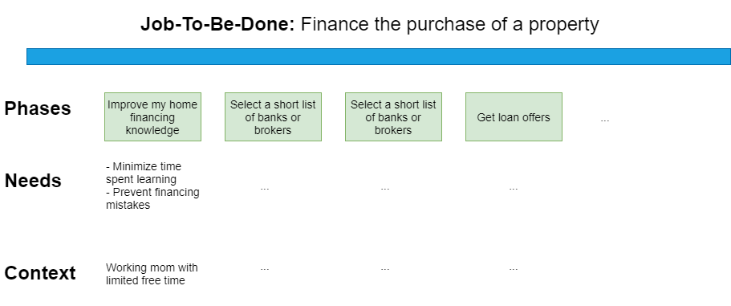
Job Map
““A Jobs Map is a view into the behaviors and needs of individuals in the context of their daily lives. That may or may not include your solution.”
Jim Kalbach, The Jobs To Be Done Playbook
A Job Map is not a Journey map
It is not about how people come to your solution, decide to purchase or stay loyal
Help discover specific innovative ideas to fulfill a job
Install Draw-io :
https://draw-io.en.softonic.com/
Double click on the icon below:

Slide 8
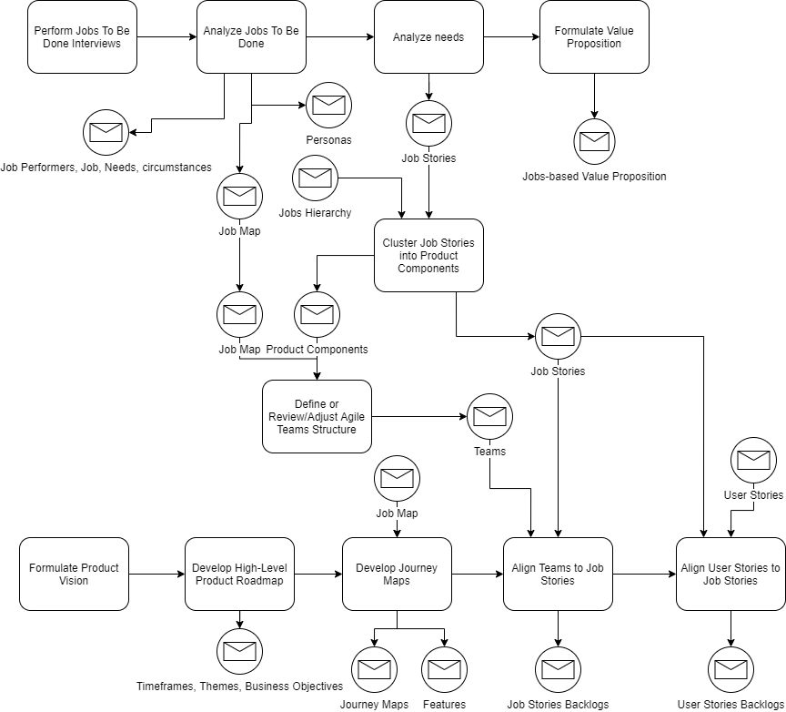
Jobs To Be Done approach
Problem Space
Solution Space
(one or more scenarios)

Slide 9
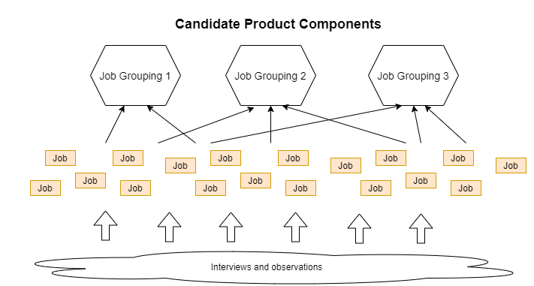
Clustering Jobs
Good solutions mirror clients’ mental model of their Job-To-Be-Done
Look for affinities among jobs
Unlike a job map, which is chronological, a model of the solution will typically have no temporal component
By matching the structure people naturally use in practice, you can set up a lasting foundation for iterating your product
Young, Indi. Mental Models . Rosenfeld Media

Slide 10
Job Story vs. User Story
A job story should make sense without having to know the larger JTBD landscape or job map. As a result, job stories have a more “plug-and-play” versatility that is often required for Agile designs and development teams.
Jim Kalbach, The Jobs To Be Done Playbook
Although User Stories are good for breaking down work, they typically fail to connect the solution with user needs and they lack an indication of why someone would behave in a certain way and what they need to get a job done
Often User Stories are derived from the capability being built, not from observing actual behavior
Job Stories are an alternative to User Stories. They follow the tradition of breaking down efforts into smaller pieces, but through the JTBD lens
Examples of Job Story Formats
When I [circumstance], I want to [job], so I can [expected outcome]
When I [circumstance + job stage/step], I want to [micro-job], so I can [need]

Slide 11
DDD Knowledge areas
Key concepts
System Thinking
Domain
Modeling constructs
Ubiquitous Language
Context
Strategic DDD
Sociotechnical DDD
Modular decomposition
Big Picture Event Storming
Bounded Context Canvas
Architecture Decision Record
Strategic Patterns
Inverse Conway maneuver
Team Topologies
Living Documentation
Domain Driven Design
Architecture Styles & Patterns
Tactical DDD
Design Event Storming
Aggregate and Sagas
Event-Driven CRC Cards
Entity Object and Identity
Value Object (Type)
Repository
Service
Event-Driven Architecture
Strangler Pattern
Hexagonal Architecture
DDD implementation techniques
…
Toolbox
Event Storming Workshop
Agile Requirements Analysis
Test Driven Development
C4
…

Slide 12

Modelling chains of domain events
Strategic DDD
Invoked on
“Aggregate”
translated into
Read Model
UI
Invoked on
generates
Command
Domain Event
Command
invokes
Policy
generates
Invoked on
External System
triggers
invokes

Slide 13
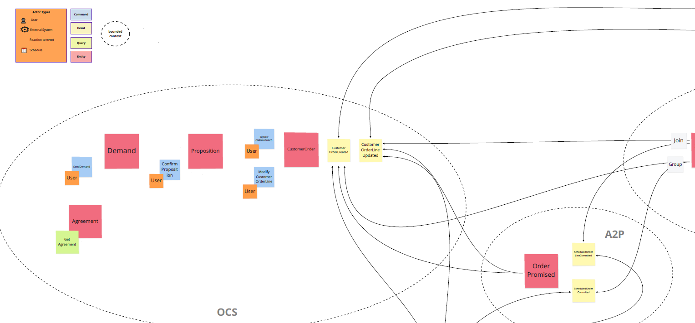
Event Storming example

Slide 14
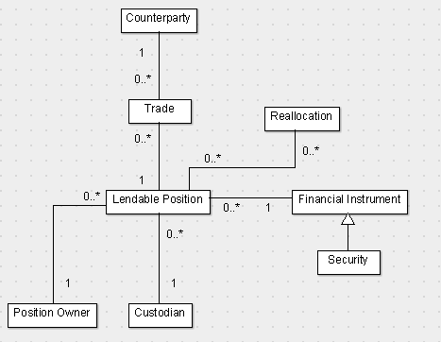
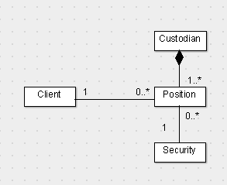
Bounded Context
Strategic DDD
Bounded Context
Description of a boundary (typically a subsystem, or work of a particular team) within which a particular model is defined and applicable
Explicitly define the context within which a model applies
Securities Lending Context
Upstream
Downstream
Custody Context
Cross context mapping:
- Security vs. Financial Instrument
- Position vs. Lendable Position

Slide 15
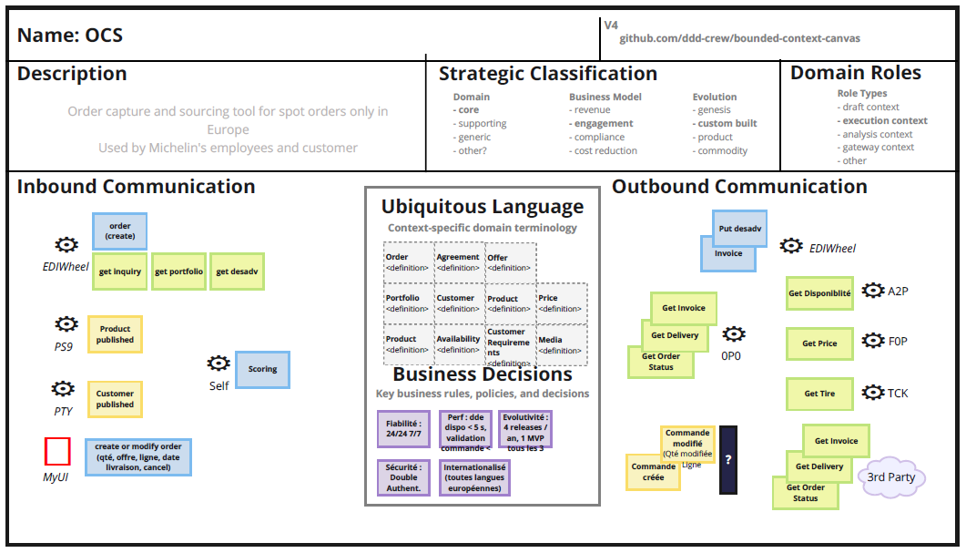
Bounded Context Canvas Example

Slide 16
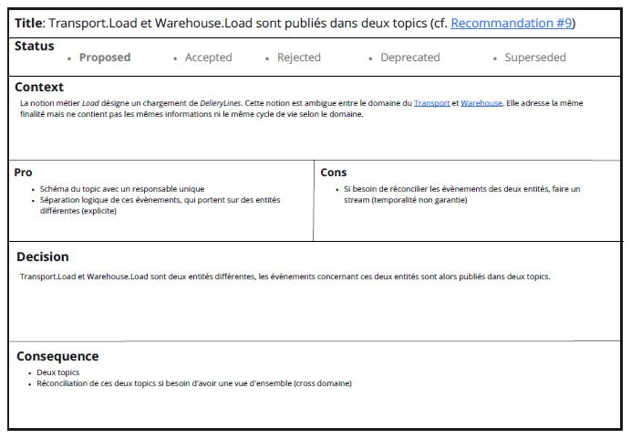
Architecture Decision Record

